Slide 1
Coronary Heart Disease Prediction Using Machine Learning Algorithms
Mid-Semester Project Presentation
Group 10 – Bug Smashers
CSE523 - Machine Learning
Course Instructor - Dr. Mehul Raval
Moksh Doshi (AU1940028), Jaimik Patel (AU1940120)
Nandish Patel (AU1940130), Jenil Bagadiya (AU1940164)

Slide 2

Introduction
CHDs are one of the major causes of death worldwide with estimates of around 17.9 million deaths in 2019 according to WHO
It is a binary classification problem having 0 as not a heart disease patient and 1 as a patient detected for the future heart disease problem.

Slide 3
Problem Statement
Our goal is to predict whether the patient will have coronary heart disease or not (binary classification) in the future using various different machine learning models.
Used a dataset obtained from Kaggle[1] which consists of 11 different features and 1 target variable. There are a total of 70000 data points in the dataset.
The prediction is made for 1 year in the future
[1] ULIANOVA, S., 2019. Cardiovascular Disease dataset. [online] Kaggle.com. Available at: <https://www.kaggle.com/datasets/sulianova/cardiovascular-disease-dataset> [Accessed 26 March 2022].

Slide 4
Existing Body of Work
The data of heart disease patients collected from the UCI laboratory is used to discover patterns with NN,DT, Support Vector machines SVM, and Naive Bayes. The results are compared for performance and accuracy with these algorithms. The proposed hybrid method returns results of 86.8% for F-measure, competing with the other existing methods in [1]
The various different research techniques considered in this work for prediction and classiﬁcation of heart disease using ML and deep learning (DL) techniques are highly accurate in establishing the efﬁcacy of these methods in [2]
[1] Cheng, C. Chiu, H., 2017. An Artiﬁcial Neural Network Model for the Evaluation of Carotid Artery Stenting Prognosis Using a Nationwide Database. 2017 39th Annual International Conference of the IEEE Engineering in Medicine and Biology Society (EMBC), pp.2566−2569
[2] Ravish, D.K. Shenoy, N.R., 2014. Heart Function Monitoring , Prediction and Prevention of Heart Attacks: Using Artiﬁcial Neural Networks. ,pp.1−6

Slide 5
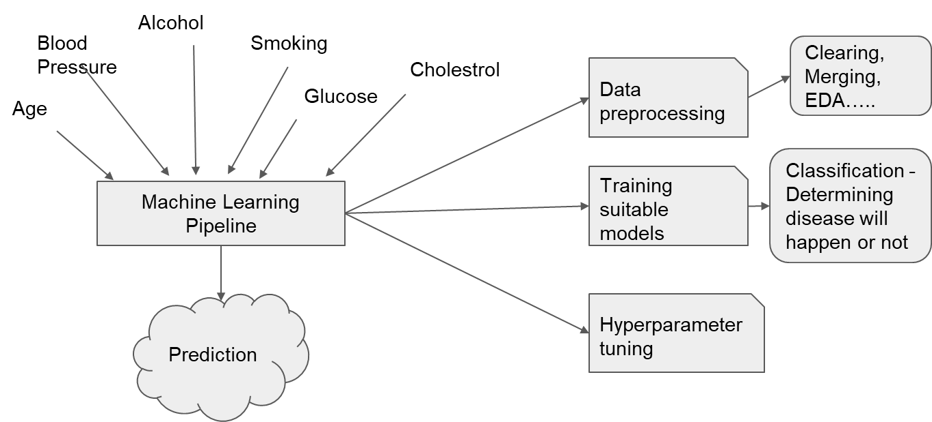
Our Approach

Slide 6


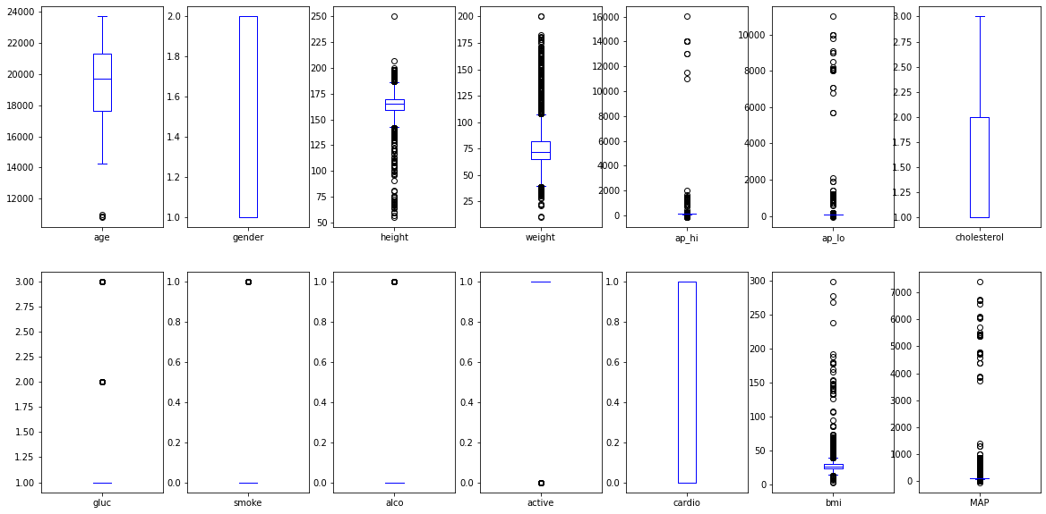
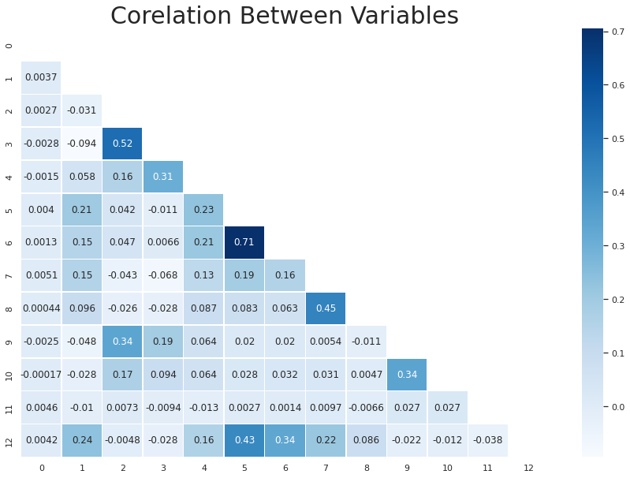
Exploratory Data Analysis

Slide 7
Exploratory Data Analysis
A box plot gives a good indication of how the values in the data are spread out. They take up less space, which is useful when comparing distributions between many groups or datasets.
Box plot helped us quickly visualize the the spread of each variable without plotting graph of each one. It helped us in picking the outlier after considering the interquartile range.
Some features such as blood pressure had negative values which would not have been caught had we not plotted a box plot
Displays how strongly each of the independent variable is correlated with each other (including the target variable)
The matrix is triangular because the upper triangle and the lower triangle are similar along the major diagonal of the square. Hence it makes sense to remove redundant values (i.e. that are simply repeated)

Slide 8

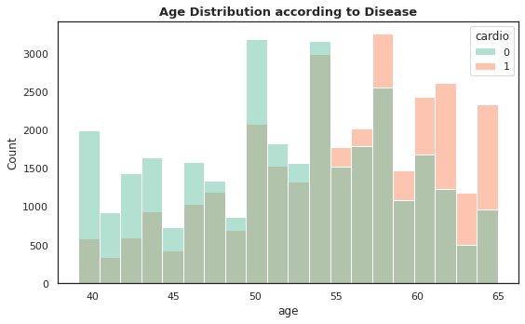
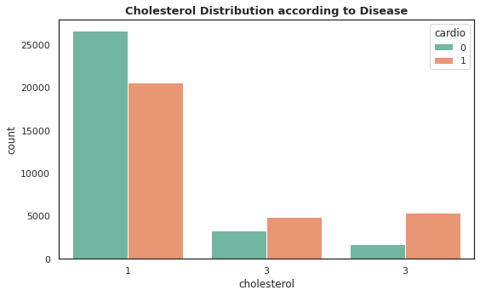
Exploratory Data Analysis Continued

Slide 9
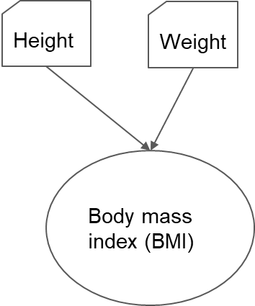
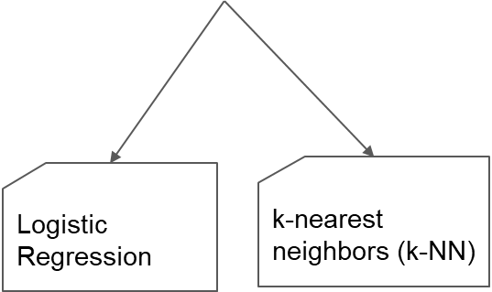
Feature Engineering Algorithms

Slide 10
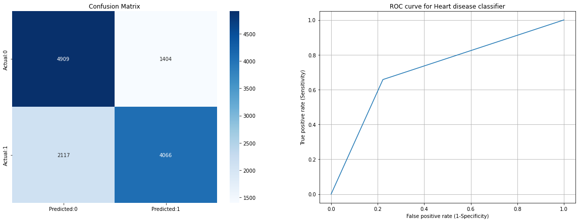
k-NN
Accuracy of the model is = 71.823%
The details for confusion matrix is =
precision recall f1-score support
0.0 0.70 0.78 0.74 6313
1.0 0.74 0.66 0.70 6183
accuracy 0.72 12496
macro avg 0.72 0.72 0.72 12496
weighted avg 0.72 0.72 0.72 12496

Slide 11
Measurement Metrics
Accuracy vs F1-Score
ROC Curve
Accuracy is the result of truely detected predictions divided by all the possible outcomes which contains truly detected as well as falsely detected predictions.
When we have similar class distribution then Accuracy can be used.
When there are various classes as the outcome then F1 score is more useful.
F1 score is a harmonic mean of recall and precision.
The library (sklearn) internally calculates threshold for ROC curve such that area under the curve attains maximum possible value.
It determines the ability of model to distinguish between classes and so its higher value is preferred.

Slide 12
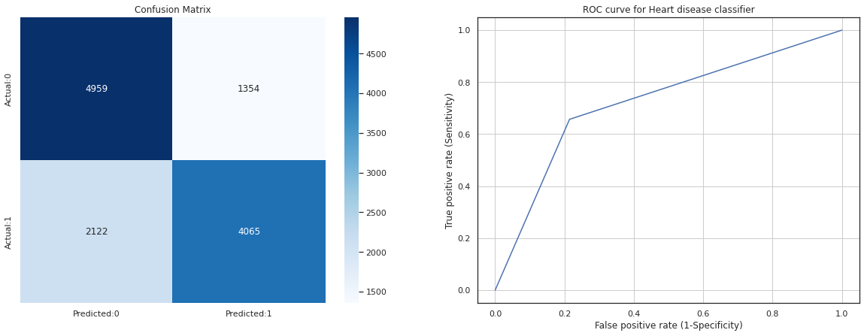
Logistic Regression
Accuracy of the model is = 71.519%
The details for confusion matrix is =
precision recall f1-score support
0.0 0.69 0.78 0.73 6313
1.0 0.74 0.65 0.69 6183
accuracy 0.72 12496
macro avg 0.72 0.71 0.71 12496
weighted avg 0.72 0.72 0.71 12496

Slide 13
Results
Classifier | Train Accuracy | Test Accuracy | Precision | Recall | F1 score
KNN | 0.7299 | 0.7182 | 0.72 | 0.72 | 0.72
KNN (feature engineering) | 0.7293 | 0.7227 | 0.73 | 0.72 | 0.72
KNN (only objective features) | 0.7309 | 0.7191 | 0.72 | 0.72 | 0.72
Logistic Regression | 0.7250 | 0.7151 | 0.72 | 0.72 | 0.71
Logistic Regression (feature engineering) | 0.7251 | 0.7151 | 0.72 | 0.72 | 0.71
Logistic Regression (only objective features) | 0.7223 | 0.7201 | 0.72 | 0.72 | 0.72

Slide 14
Role of each group member in the project
 | Exploratory Data Analysis | Data preprocessing | KNN | Logistic Regression | Feature Engineering | Literature Review and Reports
Moksh | ✔ |  | ✔ |  | ✔ | ✔
Jaimik | ✔ | ✔ |  | ✔ |  | ✔
Nandish |  | ✔ |  | ✔ |  | ✔
Jenil | ✔ |  | ✔ |  |  | ✔

Slide 15
Future Work - Algorithms
Random Forest
Decision Tree
Support Vector Machine (SVM)
Naive Bayes

Slide 16
References
R. Bharti, A. Khamparia, M. Shabaz, G. Dhiman, S. Pande, and P. Singh, “Prediction of Heart Disease Using a Combination of Machine Learning and Deep Learning,” Computational Intelligence and Neuroscience, vol. 2021. Hindawi Limited, pp. 1–11, Jul. 01, 2021. doi: 10.1155/2021/8387680.
N. Rajesh, M. T, S. Hafeez, and H. Krishna, “Prediction of Heart Disease Using Machine Learning Algorithms,” International Journal of Engineering & Technology, vol. 7, no. 2.32. Science Publishing Corporation, p. 363, May 31, 2018. doi: 10.14419/ijet.v7i2.32.15714
S. Ulianova, “Cardiovascular disease dataset,” Kaggle, 20-Jan-2019. [Online]. Available: https://www.kaggle.com/datasets/sulianova/cardiovascular-disease-dataset. [Accessed: 19-Mar-2022].
D. Shah, S. Patel, and S. K. Bharti, “Heart disease prediction using Machine Learning Techniques,” SN Computer Science, vol. 1, no. 6, 2020.
Mohan, Senthilkumar & Thirumalai, Chandra Segar & Srivastava, Gautam. (2019). Effective Heart Disease Prediction Using Hybrid Machine Learning Techniques. IEEE Access. PP. 1-1. 10.1109/ACCESS.2019.2923707.
Almustafa, K., 2020. Prediction of heart disease and classifiers’ sensitivity analysis. BMC Bioinformatics, 21(1).

